Slide 1


Health Studies Collegium Presents
Predictive Biomarkers
Supported by a grant from PIH, Ashburn VA

Slide 2
Predictive Biomarker Test Objectives
How science philosophy influences what society observes & uses
Interpret tests referenced to least risk or highest gain goal values rather than usual statistical ranges
Translate tests into quality life years QoLY sacrificed /recoverable

Slide 3
Understanding… Life as Paradox
Mechanistic, Allopathic view: Experience and interpret life as if Newtonian mechanics explains physiology & health
Quantum electrodynamic non-equilibrium systems view: Intrinsic to TCM, Eclectic, Homeopathy, Ayurveda, Kampo and Hikmet medical systems
Prigogone I and Stengers I. Order Out of Chaos: Man's New Dialogue with Nature, Bantam Books, 1984.
Korzybski A. Science and Sanity: An Introduction to Non-Aristotelian Systems and General Semantics, Institute of General Semantics, 5th Edition 1994.

Slide 4
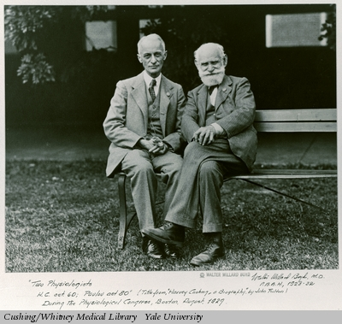
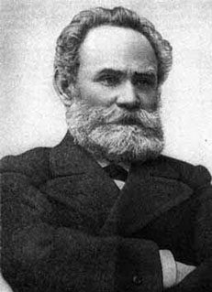
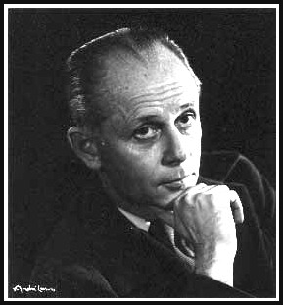
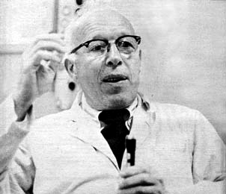
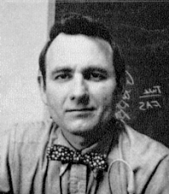
Life As It Is: Experience trumps theory
Trust experts; verify in your experience…
Practices of breath, mindfulness, autogenics, therapeutic biofeedback, & active meditation
Hope, healing touch & go by your results
Hippocrates, Huang Ti, Galen, Avicenna, Maimonides,
Paracelsus, Claude Bernard, Robert Crooke,
Harvey Cushing, Ivan Pavlov, Hans Selye, Rene Dubos,
C Norman Shealy & …
Prigogone I and Stengers I. Order Out of Chaos: Man's New Dialogue with Nature, Bantam Books, 1984
Korzybski A. Science and Sanity: An Introduction to Non-Aristotelian Systems and General Semantics. Institute of General Semantics, 5th Edition, 1994

Slide 5
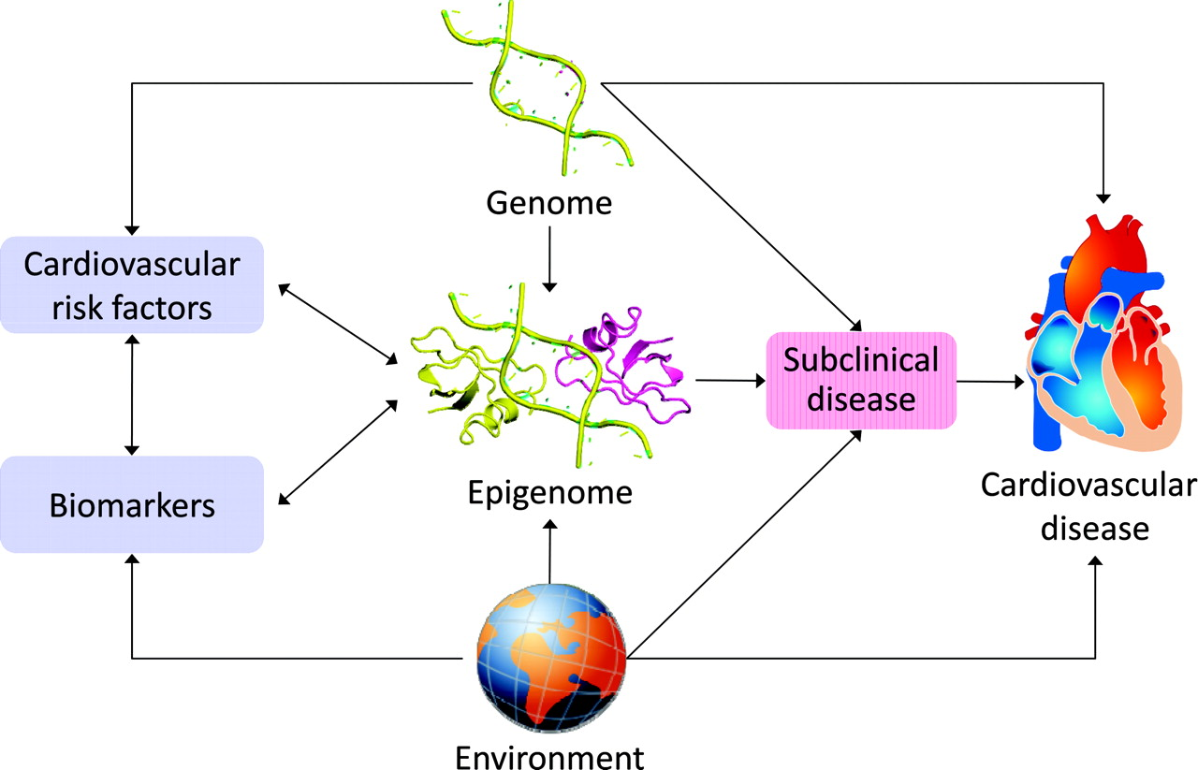
Cardiovascular Epigenetics: 92% choices
Andrea Baccarelli, Michiel Rienstra Emelia J. Benjamin. Cardiovascular Epigenetics Basic Concepts and Results From Animal and Human Studies. Circulation: Cardiovascular Genetics. 2010; 3: 567-573.

Slide 6
Predictive Biomarker Tests
What are they
Why they are important
How to use in practice
Evidence based personal care

Slide 7
Predictive Biomarkers….
Trust experts; verify with biomarkers
Functional
Risk stratified; +/- QoLY
Jaffe R. Predictive Biomarkers to Guide and Compare Clinical Outcomes, HSC-1301

Slide 8
Predictive Biomarker Characteristics
‘Up stream’ measures & assessments
Address causes more than consequences
Recognize causes and effects
Predict health risk years to decades ahead
Measure global systems
Widely used on large populations

Slide 9
6 Predictive Biomarkers
Hgb A1c
Homocysteine
hsCRP
Oxidized LDL/HDL & 8 oxo-guanine
Vitamin D
1st AM urine pH

Slide 10
Predictive Biomarker Categories
Hgb A1c: Sugar, insulin, energy metabolism
Homocysteine: Methylation, epigenetics, detox
hsCRP: Inflammation, repair ability
Oxidized LDL/HDL & 8 oxo-guanine: Antioxidant sufficiency,
oxidative stress free radical activity
Vitamin D: Cell communication & adhesion
1st AM urine pH: Mineral status & acidosis risk

Slide 11
Predictive Biomarkers correlate with
Hgb A1c: Energy for surveillance & repair
Homocysteine: Transport balance, sulfur cycles
hsCRP: Renewal or calls for reserves
Oxidized LDL/HDL & 8 oxo-guanine: Antioxidant status & oxidative damage risk
Vitamin D: Cells knowing enough is enough
1st AM urine pH: Buffering minerals in cells
Chronic, degenerative, autoimmune & CVD

Slide 12
Predictive Biomarker 1
Hemoglobin A1c = Hgb A1c
Sugar – insulin – growth factor - energy

Slide 13
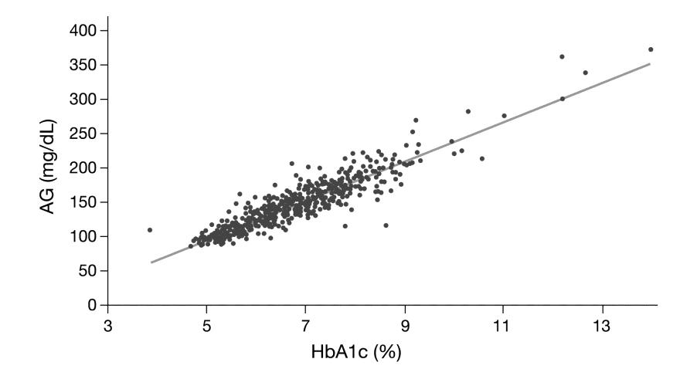
Hgb A1c Predicts AG (Average Glucose; Blood Sugar)
Hinzmann R, Schlaeger C, Tran C T. What Do We Need beyond Hemoglobin A1c to
Get the Complete Picture of Glycemia in People with Diabetes? Int. J. Med. Sci. 2012, 9: 665-681
Notes:
The A1c-Derived Average Glucose (ADAG) Study Group demonstrated that HbA1c correlates well with average glucose (AG) (R2 = 0.84) [23], however, although 90% of HbA1c concentrations predicted the average measured glucose within ± 15%, significant deviations were observed. The regression equation is: Calculated AG (mg/dL) = 28.7 x HbA1c (%) - 46.7.

Slide 14
Hgb A1c is Primary Biomarker
Bunn HF, Haney DN, Gabbay KH, Gallop PM. Further identification of the nature and linkage of the carbohydrate in hemoglobin A1c. Biochem Biophys Res Commun. 1975; 67(1): 103-109.
Rolf Hinzmann , Christof Schlaeger, Cam Tuan Tran.
What Do We Need beyond Hemoglobin A1c to Get the Complete Picture of Glycemia in People with Diabetes?
Int J Med Sci 2012; 9(8):665-681. doi:10.7150/ijms.4520
Tara L. Gruenewald, Teresa E. Seeman, Carol D. Ryff, Arun S. Karlamangla, Burton H. Singer.
Combinations of biomarkers predictive of later life mortality.
PNAS September 19, 2006; 103(38): 14158-14163
Notes:
Paul Gallop extended his interest in glycosylation of collagen to glycosylation of proteins in general and developed the Hgb A1c test as a result.
Rolf Hinzman reviews the strength of the evidence the Hgb A1c is highly predictive of blood sugar levels and all cause morbidity and mortality.
Tara Gruenewald et al review multiple biomarkers and find 6 to be more predictive seen on next slide.

Slide 15
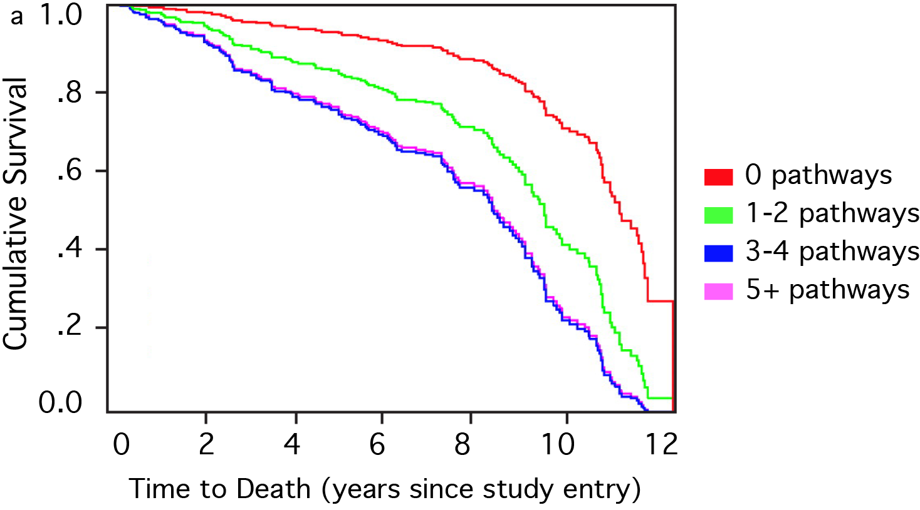
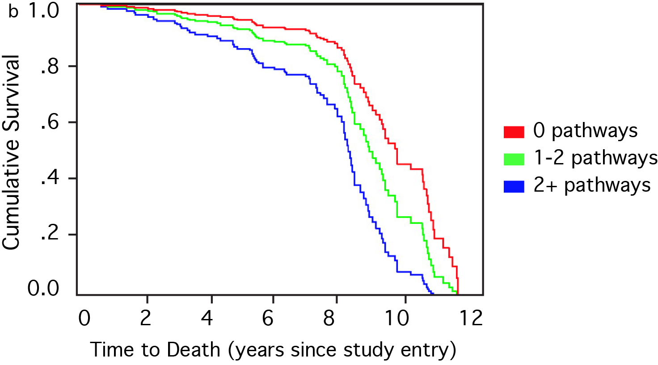
6 biomarkers predict survival in men (a) and women (b):
Hgb A1c, SBP, DBP, hsCRP, IL-6, DHEA
Men
Women
Gruenewald T L et al. PNAS 2006;103:14158-14163
©2006 by National Academy of Sciences
Notes:
Survival over the 12-year follow-up period as a function of representation in varying numbers of HR pathways in the male (a) and female (b) health forest information trees. Tara L. Gruenewald, Teresa E. Seeman, Carol D. Ryff, Arun S. Karlamangla and Burton H. Singer. Combinations of biomarkers predictive of later life mortality. PNAS September 19, 2006 vol. 103 no. 38 14158-14163

Slide 16
Hgb A1c Biomarker Solutions
Essential nutritives for heathy Hgb A1c level < 5 mg/dl
Fiber: 40+ g/day
Probiotics: 40+ Bn organisms
Immunotolerant diet based on LRA by ELISA/ACT tests
Herbal synergistic sugar regulators when active forms used:
Standardized corosolic (from Banaba leaf extract ~4% HPLC) 50 mg*
Chromium (as citrate) 250 mcg*
Vanadium (as ascorbate) 250 mcg*
French lilac (Galega officinalis) 150 mg*
Bitter melon/Marah (Momordica Charantia) 150 mg*
Huckleberry/Bilberry (Vaccinum myrtillus) 100 mg*
Agnus castus (Chaste tree berry) 250 mg*
Phosphatidylcholine 71mg*

Slide 17
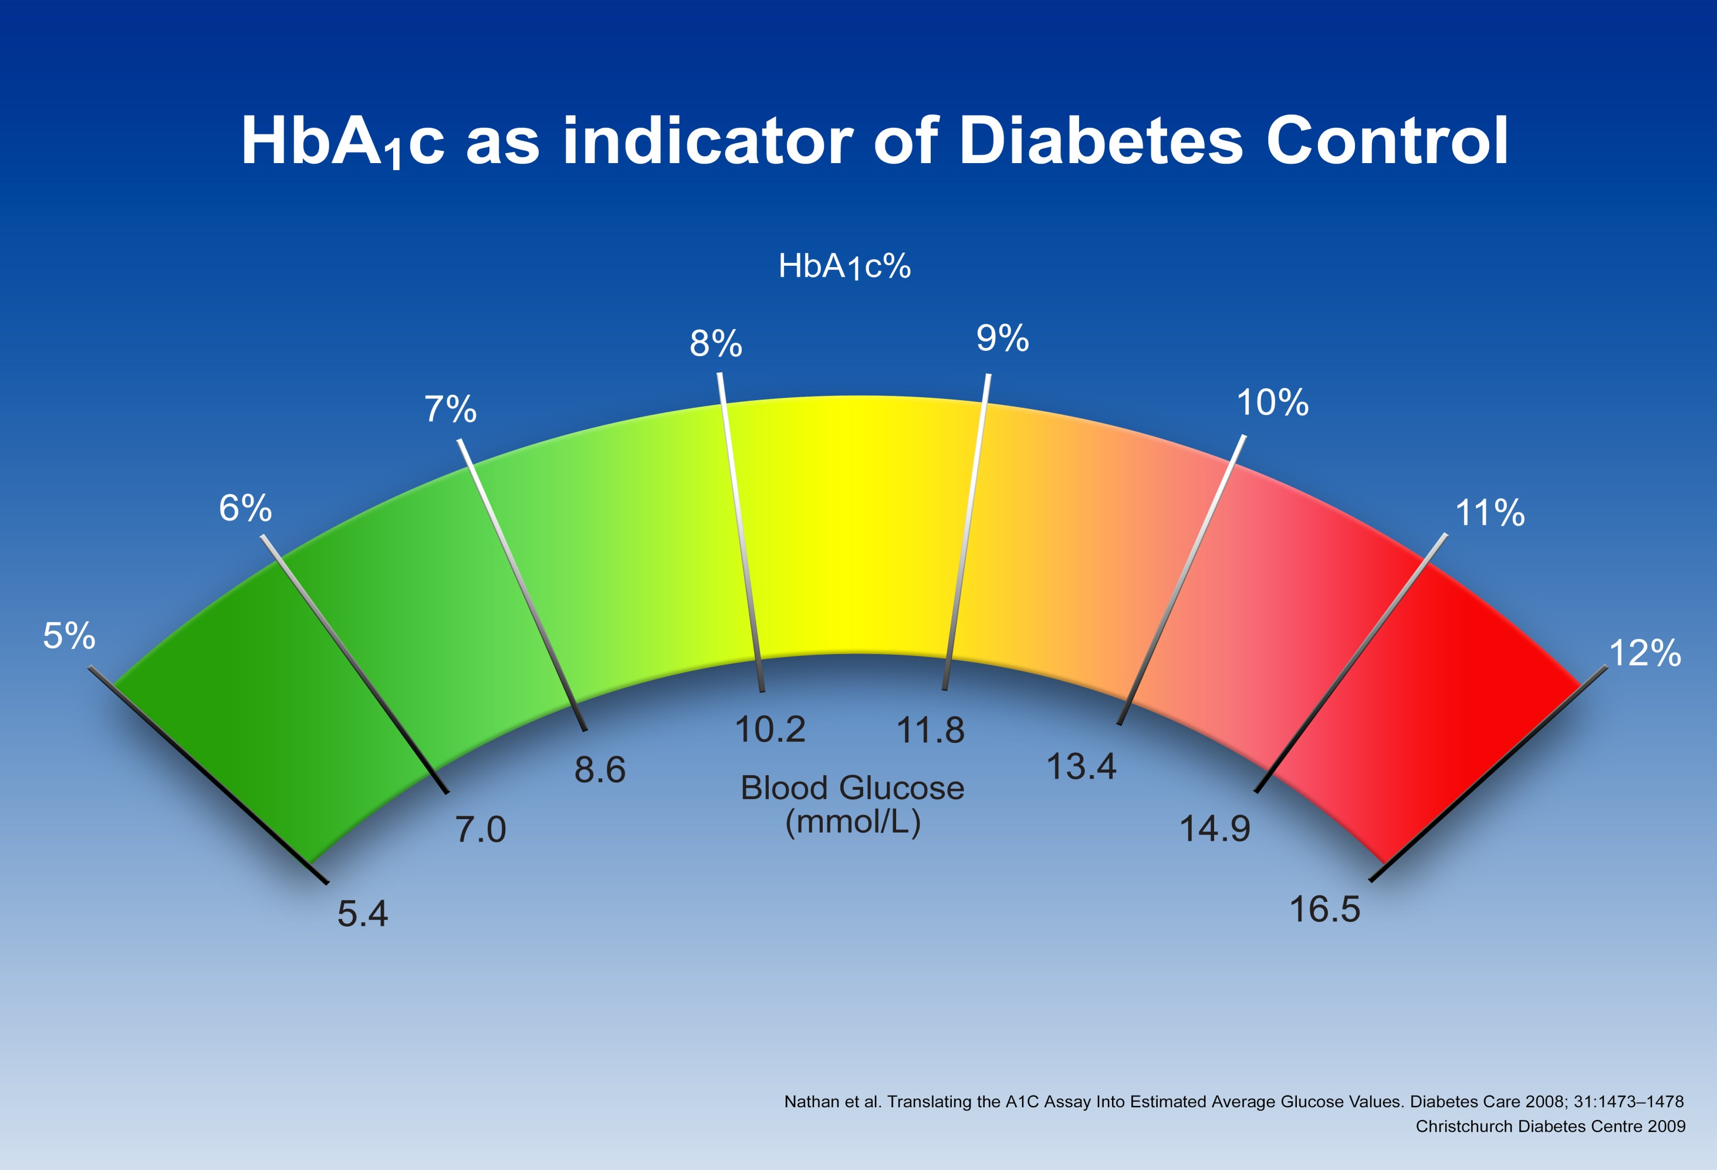

Slide 18
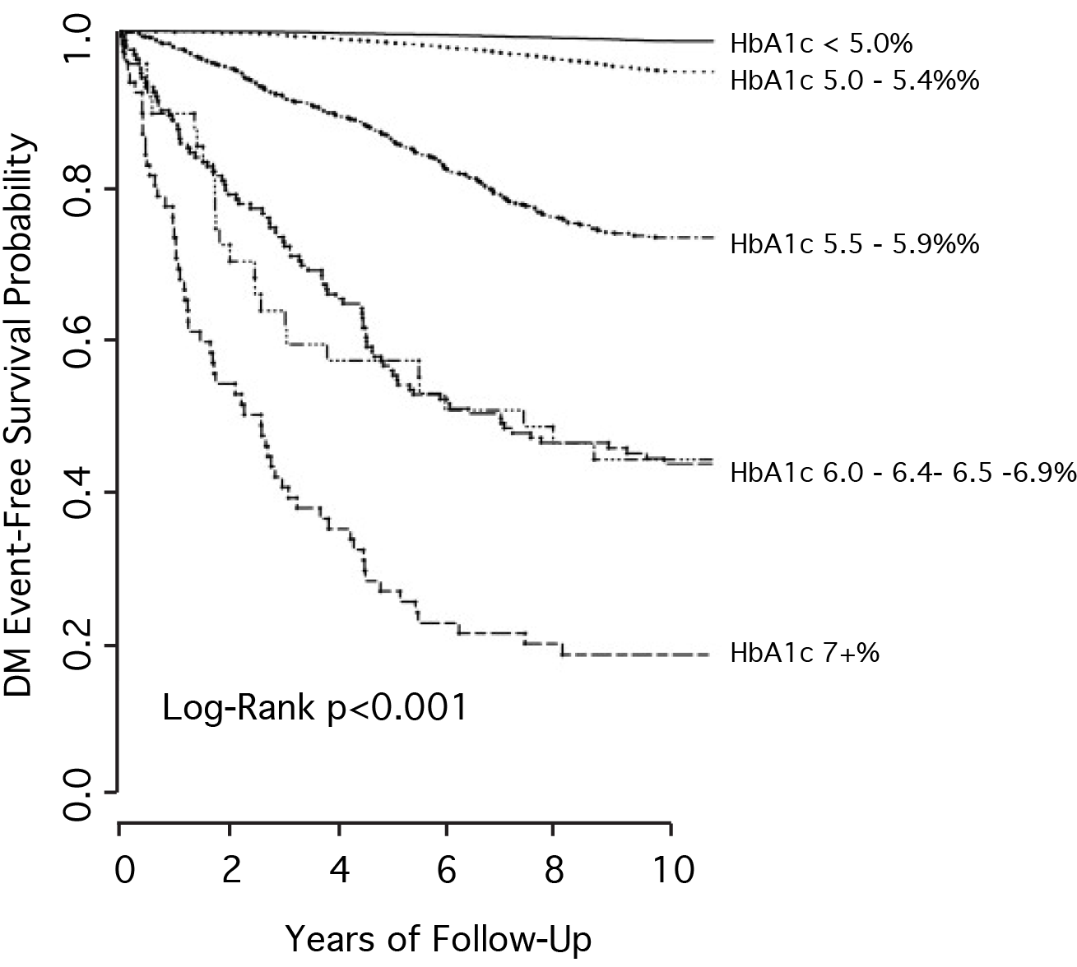
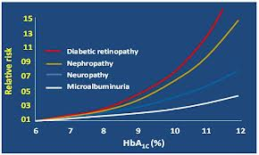
Hgb A1c is Primary Biomarker
Rashid Ansari, Saiqaa Ansari . Effectiveness of Fenugreek for Lowering Hemoglobin (HbA1c) in Patients with Self-Management of Type 2 Diabetes: A Randomized Controlled Trial in Medical Complications of Type 2 Diabetes.
Colleen Croniger (Ed.), 2011 CC BY-NC-SA 3.0 license
Pradhan A, Rifai N, Buring J, Ridker P. Hemoglobin A1c Predicts Diabetes but Not Cardiovascular Disease in Nondiabetic Women. The American Journal of Medicine. 2007; 120 (8): 720-727.

Slide 19
Insulin & Blood Sugar Control
Liver
GLUCOSE PRODUCTION
Blood Glucose
Insulin
GLUCOSE UPTAKE
Muscle:
Fat from sugar
(as energy store); receptors can be resistant
Pancreatic Islet Cells
Secretion triggers
blood glucose
19
Notes:
Note: Fructose enters cells freely then becomes glucose… no free lunch and trying to fool the body is counter productive

Slide 20
Predictive Biomarker 2
Homocysteine

Slide 21
Homocysteine is Primary Biomarker
Methylation, detoxification, transport
Elective protectives or survival mode
Cardiovascular & stroke risk marker
Sulfur aminoacid pools

Slide 22
Homocysteine Levels Predict Survival in CHD
<6 μmol/L
<9 μmol/L
9-15 μmol/L
16X
4X
15-20μmol/L
>20 μmol/L
Nygård O, Nordrehaug JE, Refsum H, Ueland PM, Farstad M, Vollset SE.
Plasma homocysteine levels and mortality in patients with coronary artery disease.
New Engl J Med. 1997 Jul 24; 337(4): 230-236

Slide 23
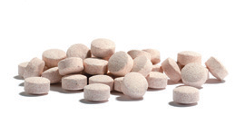
Healthy Methylation: B Complex, C
Difference in Five-Year Mortality Risk
Difference in Senility Risk
Arch Chem. 2004;50:3-32.
Arch Intern Med 2003;163:1933-1937.
NEJM. 2002;346:476-483.
Schroecksnadel K, et. al. Hyperhomocysteinemia &
immune activation.
Clin Chem Lab Med 2003; 41(11):1438-1443.

Slide 24
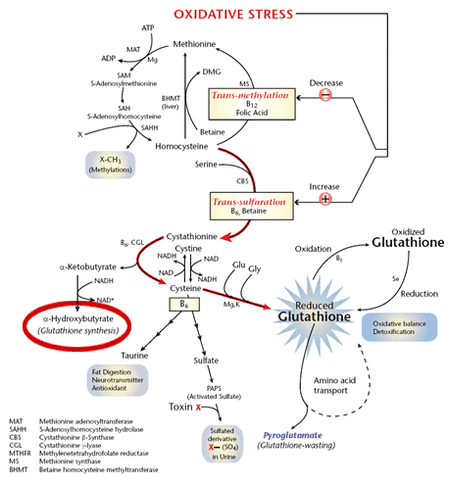
Healthy Methylation
Nimni ME, Han B, Cordoba F.
Are we getting enough sulfur in our diet?
Nutr Metab (Lond). 2007; 4: 24.

Slide 25
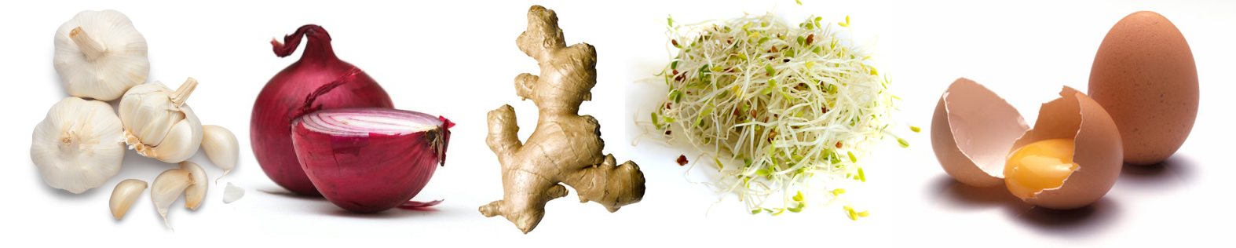
Homocysteine Biomarker Solutions
BioDetox Five Super Foods
Garlic, ginger, onions, broccoli sprouts, eggs
GGOBE
Sulforaphane, IP6, minerals
Jaffe R. Diabetes as an Autoimmune-immune Dysfunction Syndrome in Bioactive Foods in Chronic Disease States. R R Watson, Ed, Elsevier, 2013: in press

Slide 26
Homocysteine Biomarker Solutions
Colors of life: Carotenoids & B complex
Carotenoids: Alpha & beta carotene, astaxanthin, zeaxanthin, cryptoxanthin, lutein
B complex balanced natural forms:
B1, B3, B6, B12, Folate, PABA, Inositol, Choline
Clinical pearl:
Keep urine sunshine yellow
Sublingual methylation factors more predictable to bring Homocysteine < 6 mg/dl
Chew BP, Park JS. Carotenoid action on the immune response. J Nutr. 2004 Jan;134(1):257S-261S.
D'Adamo CR, Miller RR et al. Higher serum concentrations of dietary antioxidants are associated with lower levels of inflammatory biomarkers during the year after hip fracture. Clin Nutr. 2012 Oct;31(5):659-65
James Brady & Patrick Holford. Homocysteine Revisited the H* Factor Solution,
Basic Health Publications, Inc, North Bergen, N.J., 2003

Slide 27
Predictive Biomarker 3
High Sensitivity C Reactive Protein = hsCRP

Slide 28
hsCRP is Primary Biomarker
Inflammation in pathology =
Repair deficit in physiology
Healthy body repairs without hsCRP that calls for reserves to complete repair; an inducible rapid response protein
Vavuranakis M, Kariori MG, Kalogeras KI, Vrachatis DA, Moldovan C, Tousoulis D, Stefanadis C. Biomarkers as a guide of medical treatment in cardiovascular diseases.
Curr Med Chem. 2012;19(16):2485-2496
Silva D, Pais de Lacerda A. High-sensitivity C-reactive protein as a biomarker of risk in coronary artery disease, Rev Port Cardiol. 2012;31:733-745

Slide 29
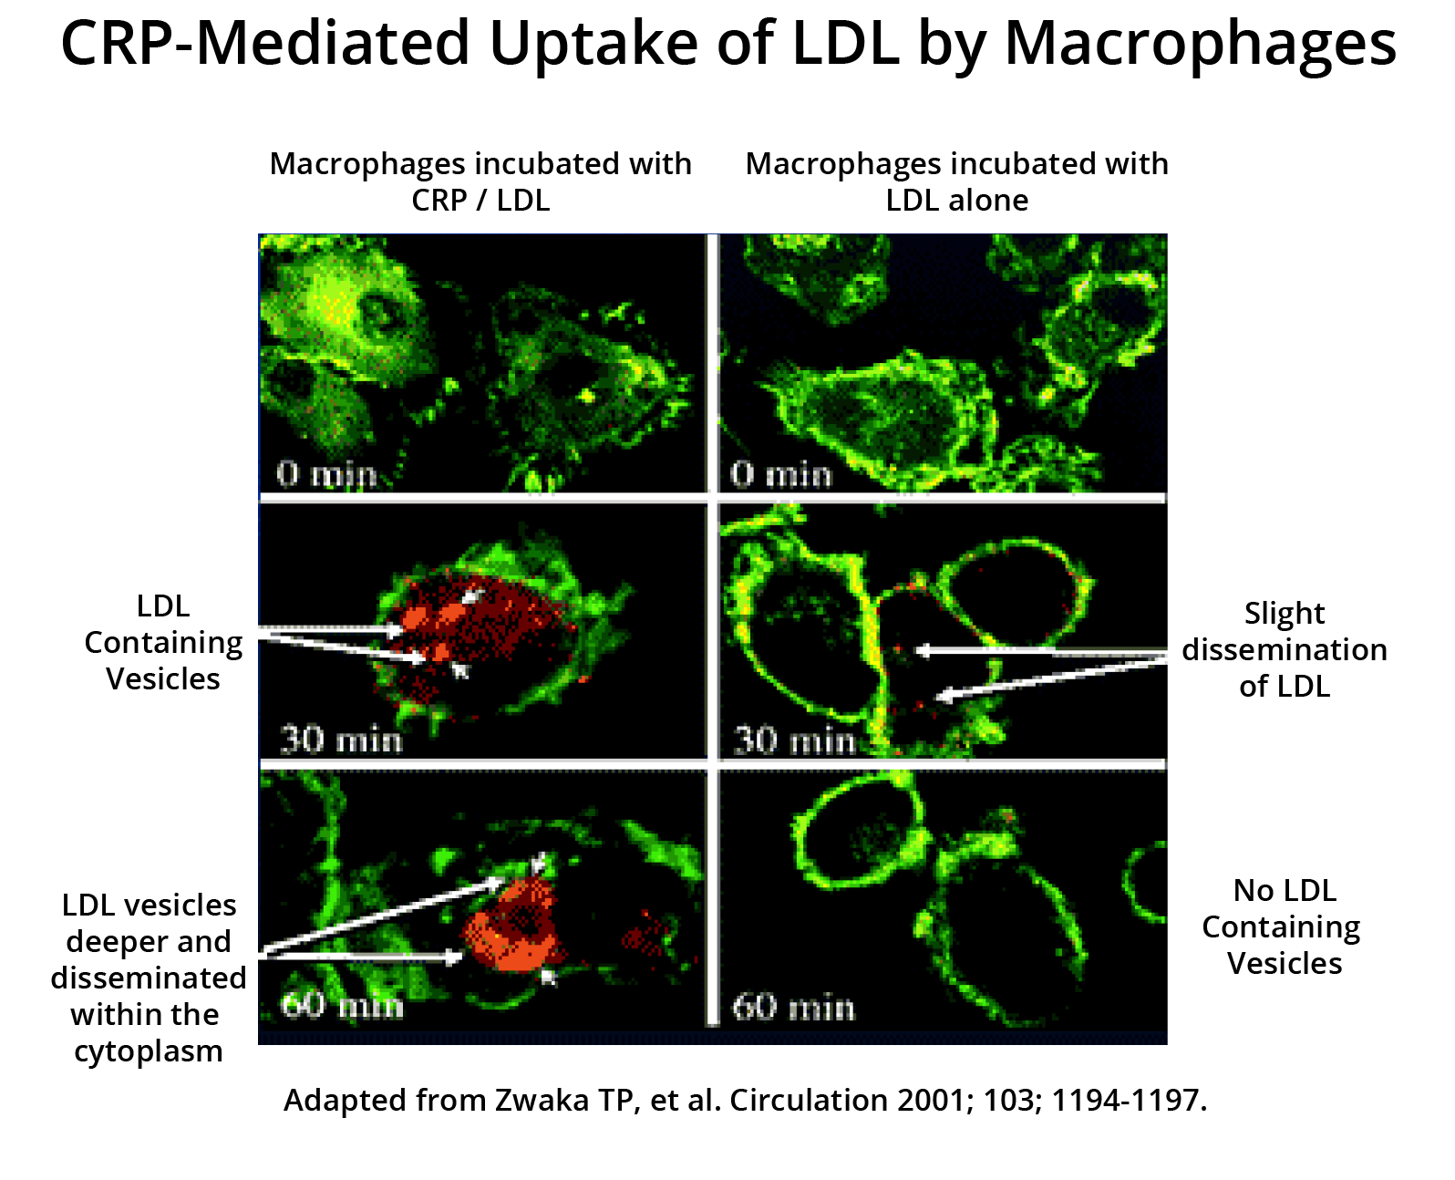
hsCRP is physiologic cry for repair
Silva D, Pais de Lacerda A. High-sensitivity C-reactive protein as a biomarker of risk in coronary artery disease, Rev Port Cardiol. 2012;31:733-745

Slide 30
ARIC, Circulation 2004;109:837-842
Interaction of CRP & Lp-PLA₂ CHD Risk in ARIC Study
Multiply risk when Lp-PLA2 and CRP levels increase
Low risk when
Lp-PLA2 levels
are low
C M Ballantyne, R C Hoogeveen, H Bang, J Coresh, A R Folsom, G Heiss, A R Sharrett, Lipoprotein-Associated Phospholipase A₂, High-Sensitivity C-Reactive Protein, and Risk for Incident Coronary Heart Disease in Middle-Aged Men and Women in the Atherosclerosis Risk in Communities (ARIC) Study Circulation. 2004; 109: 837-842.

Slide 31
Moving Toward an hs-CRP Modified Framingham Risk Score
CRP Modified Framingham Risk
Hs-CRP mg/L
Calculated Framingham 10-Year Risk
Ridker PM, Wilson PWF, Grundy SM. Circulation 2004; 109;2818-2925

Slide 32
hsCRP is Primary Biomarker
Inflammation in pathology =
repair deficit in physiology
Adequate ascorbates, polyphenolics & other antioxidants enhance repair and reduce ‘cries’ for health such as hsCRP, ferritin, COX2, IL-6
Jaffe R, Mani J. Polyphenolics Evoke Healing Responses: Clinical Evidence and Role of Predictive Biomarkers. In RR Watson, Preedy V and Zibadi S (Eds) Polyphenols in Human Health and Disease, Elsevier, 2013.
Jaffe R, Cardioprotective Nutrients. In Watson, and Preedy V (Eds) Bioactive Food as Dietary Interventions for Cardiovascular Diseases, Elsevier, 2013.

Slide 33
hsCRP Biomarker Solutions
Pro repair, Anti-inflammatory antioxidant nutrients
Ascorbates intake personalized cleanse
Quercetin dihydrate + soluble OPC ± pomegranate
3. Carotenoids, B complex methyl cofactors
4. BioDetox 5 Super Sulfur Foods
5. Vitamins D3 and mixed natural Es

Slide 34
hsCRP Predictive Biomarkers
Ascorbates: Central Protective Antioxidant
Intake based on individual cleanse*
in vivo always protective;
100% l-ascorbate, fully reduced & buffered
• Recycles tocopherols, lipoate, GSH, taurine, NAD, FAD, DNA, PUFA [Omega 3 & Omega 6], cytochromes,
• Sets cell ReDox level: Fe^{++/+++,} Cr,
• Quench oxidative damage, trap free radicals
•Donates electrons: ATP in mitochondria battery
Englard S, Seifter S. The biochemical functions of ascorbic acid. Annu Rev Nutr. 1986;6:365-406.

Slide 35
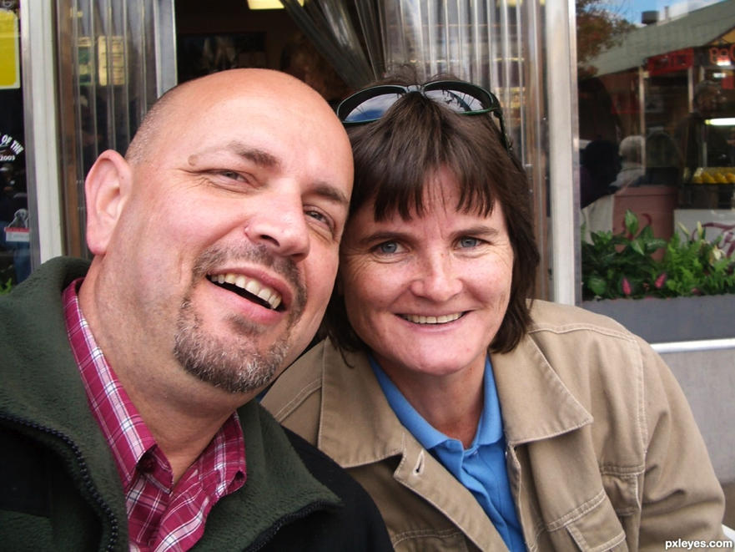
Chronic Inflammation = Chronic Disease = Chronic Repair Deficit
Yet
Two Americans
Every minute have
avoidable coronary events

Slide 36
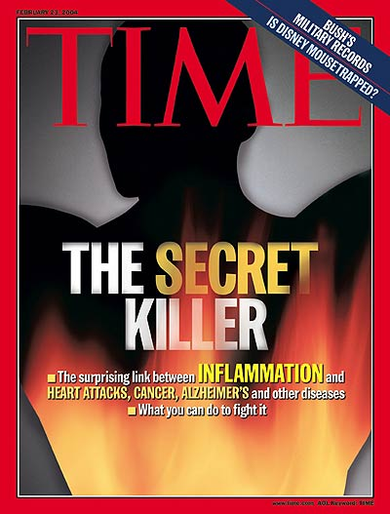
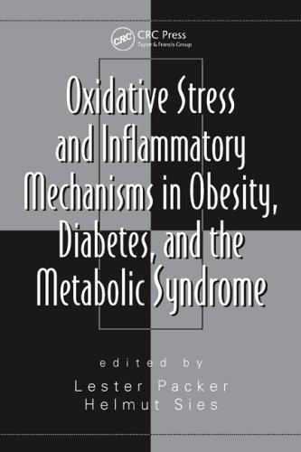
Chronic Inflammation = Chronic Disease = Chronic Repair Deficit
By 2025 in US:
~ 50 MM Diabetics
& 100 MM
Prediabetics
Source: CDC and AHA

Slide 37
ReThink Systemic Inflammation
Inflammation
Cancer
Cardiovascular diseases
Alzheimer
Diabetes II
Arthritis
Autoimmune Diseases
Neurological Diseases
Pulmonary Diseases

Slide 38
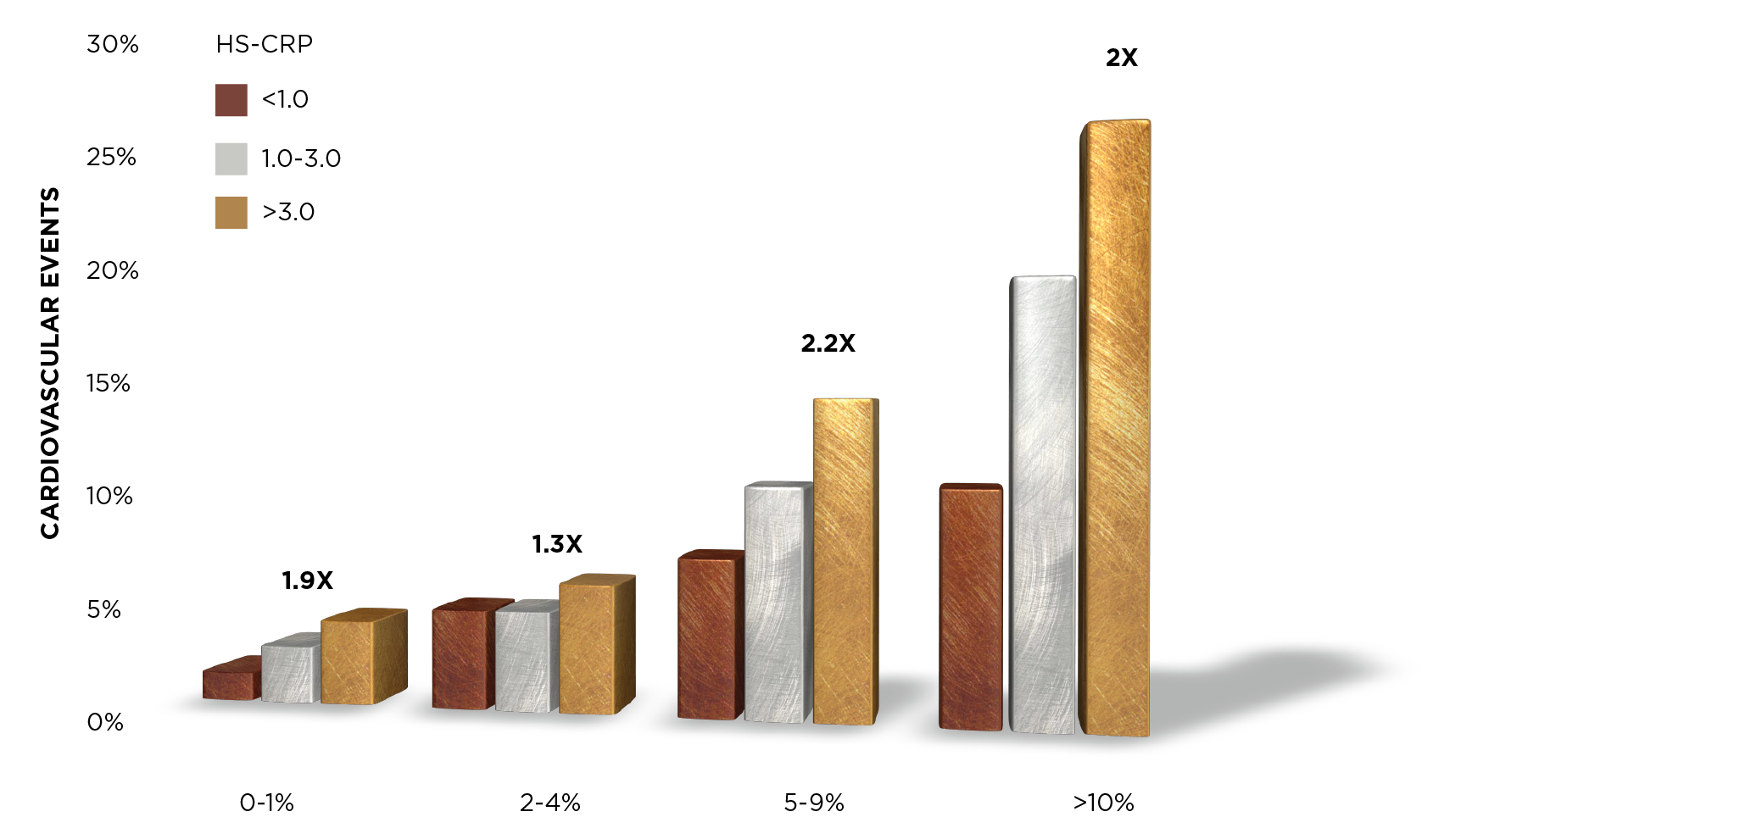
Ridker PM et al, N Engl J Med, 2002;347:1557
Actual Cardiovascular Events Compared with Framingham Estimate
+ hs-CRP in the WHS

Slide 39
Support for hsCRP as predictive biomarker
Actual Cardiovascular Events Compared with Framingham Estimate + hs-CRP in the WHS
2X
hs-CRP
Cardiovascular Events
2.2X
1.3X
1.9X
Framingham Risk Estimate
Ridker PM et al, N Engl J Med 2002;347:1557-1565

Slide 40
Predictive value of multiple biomarkers
JUPITER Trial: Rosuvastatin 20 mg in Older,
Normolipidemic Subjects w/ ↑ hsCRP, N=17,802
Men >50, women >60 years old CVD/DM (mean 66)
LDL <130 (TC 186, LDL 108, HDL 49, TG 118)
hsCRP >2 mg/L (mean 4.3)
BMI 28, BP 134/80, FBG 94, Hgb-A1C 5.7%
Metabolic syndrome 41%
13.6% 10-yr CV risk with placebo (intermediate)
Study stopped early (1.9 years)*
*Ridker PM, The JUPITER Trial Results, Controversies, and Implications for Prevention
Circulation: Cardiovascular Quality and Outcomes. 2009; 2: 279-285

Slide 41
Support for predictive value of multiple biomarkers
JUPITER Trial: Rosuvastatin 20 mg in Older,
Normolipidemic Subjects w/ ↑ hsCRP
MI, stroke, USA, revasc, CV death
MI, stroke, CVE death
Treatment Effect
All P <0.01 NNT 26-120
Ridker PM, The JUPITER Trial Results, Controversies, and Implications for Prevention Circulation: Cardiovascular Quality and Outcomes. 2009; 2: 279-285

Slide 42
Support for hsCRP as Predictive Biomarker
CRP & Lp-PLA₂ for CHD Risk in ARIC Study
3X
Relative Risk for CHD
Ballantyne CM, Hoogeveen RC, Bang H, Coresh J, Folsom AR, Heiss G, Sharrett AR. Lipoprotein-Associated Phospholipase A2, High-Sensitivity C-Reactive Protein, and Risk for Incident Heart Disease in Middle-Aged Men and Women in the Atherosclerosis Risk in Communities (ARIC) Study. Circulation. 2004; 109: 837-42.

Slide 43
hsCRP as Predictive Biomarker
CRP, LDL Particle Size and Apo B CHD Risk
Mean Particle Size
3X
Relative Risk for CHD
1X
Lamarche B, Tchrnof A, Moorjani S, Cantin B et al, Small, Dense Low-Density Lipoprotein Particles as a Predictor of the Risk of Ischemic Heart Disease in Men: Prospective Results From the Quebec Cardiovascular Study. Circulation. 1997; 95: 69-67.

Slide 44
Predictive Biomarker 4 & 5
Oxidative Stress Markers; Antioxidant Status
Oxidized HDL/LDL & 8-Oxo-Guanine

Slide 45
Oxidized LDL/HDL & 8-oxoguanine are Primary Biomarkers
PUFAs become amplifiers: cytokines
Oxidized PUFA, cholesterol etc interfere
8-Oxoguanine reflects DNA oxidative risk
Adequate antioxidants prevent free radicals
DNA / RNA translation & transcription
Mabley JG, Pacher P, Deb A, Wallace R, Elder RH, Szabó C Potential role for 8-oxoguanine DNA glycosylase in regulating inflammation FASEB J 2005 Feb;19(2):290-292.

Slide 46
Oxidized LDL/HDL & 8-oxoguanine Solutions
Pro repair, Anti-inflammatory antioxidant nutrients
Ascorbates intake personalized cleanse
Quercetin dihydrate + soluble OPC ± pomegranate
3. Carotenoids, B complex methyl cofactors
4. BioDetox 5 Super Foods
5. Vitamins D3 and mixed natural Es

Slide 47
Individual Ascorbate Needs
Ascorbate cleanse (C Flush) protocol*:
± Probiotics, recycled glutamine, Mag, Polyphenolics
Healthy
1.5 grams; ½ tsp
Every 15 min
Moderate Ills
3 grams; 1 tsp
Chronic Ills
6 grams; 2 tsp
6 grams / hour
Every 15 min
12 grams / hour
Every 15 min
24 grams / hour
* Health Studies Collegium, The Joy of Food The Alkaline Way Guide, 19th ed. 1990-2013.

Slide 48

100% l-Ascorbates, reduced, buffered
Ascorbates pump toxins out…

Slide 49
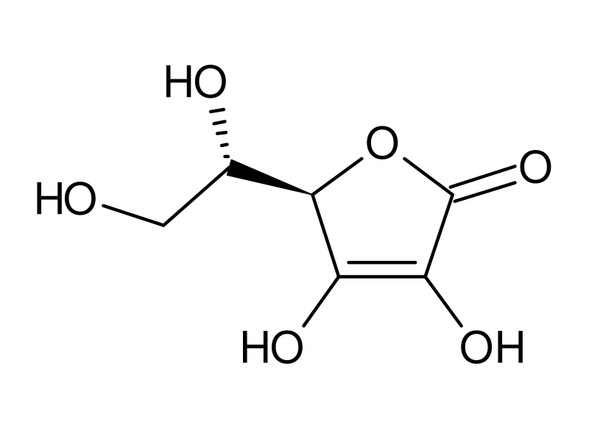
Ascorbate: Toxic Mineral Excretion
1 gm ascorbate =
1,000 mg =
1,000,000 mcg;
~0.01% can bind ToxMin =
1,000 mcg ascorbate
binds ~0.1 µmol ToxMin =
~ 10 mcg ToxMin / gm Asc
Daily ToxMin exposure =
~ 2 gm ascorbate/day to
safely protect & excrete

Slide 50
Ascorbate needs from 4-100+ g/day

Slide 51
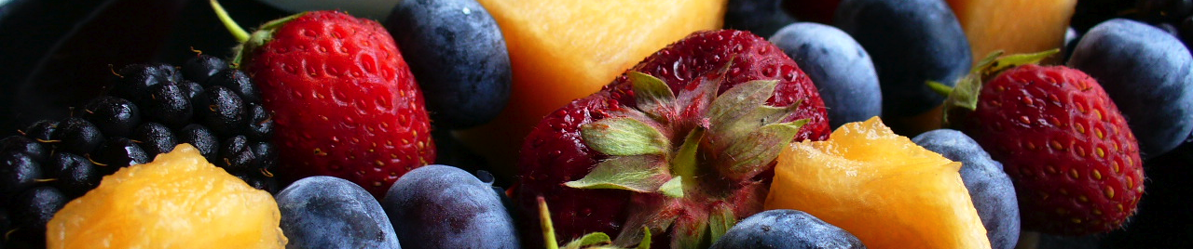
Predictive Biomarkers: Helpful synergists
Flavonoids & Flavanols… Polyphenolic Ascorbate synergists
Quercetin dihydrate 0.5-20 g + soluble OPC
± pomegranate, tabsules, based on oxidative stress need
Clinical pearl: Protect & Activate repair; recycles cell ascorbate
Safer, synergistic… anti-histaminic, steroid sparing
Activate elective protectives, detox, recycling
Middleton, E. et al. The effects of plant flavonoids on mammalian cells: implications for inflammation, heart disease and cancer. Pharmacol Rev, 2000; 52: 673-751.
Kim YJ, Park HJ, Yoon SH, Kim MJ, Leem KH, Chung JH, Kim HK. Anticancer effects of oligomeric proanthocyanidins on human colorectal cancer cell line, SNU-C4
World J Gastroenterol. 2005 Aug 14;11(30): 4674-4678.

Slide 52
Predictive Biomarker 6
Cell Communication = Vitamin D =
25 OH-Cholecalciferol = 25 OH-D

Slide 53
Vitamin D is Primary Biomarker
Liver & Kidney hydroxylation
Adhesion molecule between cells
Communicates when enough is enough
Bone, vessel, and brain health
Anti-cancer surveillance system
40+ MM poorly absorb D from gut

Slide 54
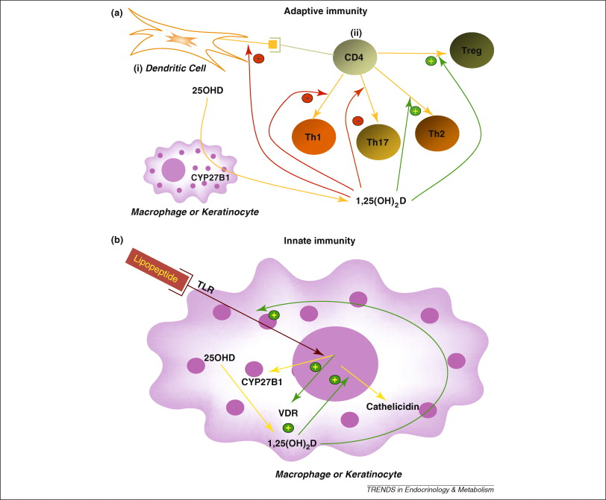
Vitamin D is Primary Biomarker

Slide 55
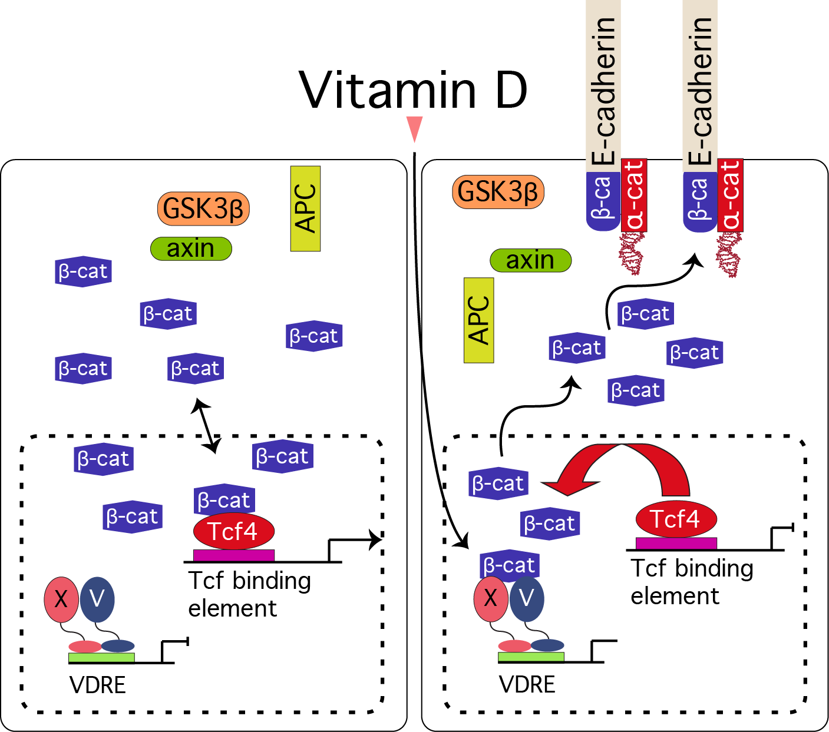
Vitamin D is Primary Biomarker
Ana M. Jiménez-Lara Colorectal cancer: Potential therapeutic benefits of Vitamin D
The International Journal of Biochemistry & Cell Biology Volume 39, Issue 4, 2007, Pages 672–677

Slide 56
Vitamin D Predictive Biomarkers Solutions
Vitamins D & E
Vitamin D3: 500 IU/drop w/rosemary oil preservative
Deficiency CRP, IL-10 & insulin resistance
Maintain 25-OH D in 50-80 ng/ml range*
Vitamins E:
Mixed natural tocopherols (all 8 forms, 800-3200 IU)**
ox LDL & platelet aggregation vasodilation
*Heaney RP. Vitamin D in health and disease. Clin J Am Soc Nephrol. 2008 Sep;3(5): 1535-1541.
**Shute, EV .Proposed study of vitamin E therapy. Can Med Assoc J. 1972 May 20;106(10): 1057-1058.

Slide 57
Predictive Biomarker 7
Cell mineral and acid status
Metabolic acidosis risk
1st Urine pH after 6 hours rest

Slide 58
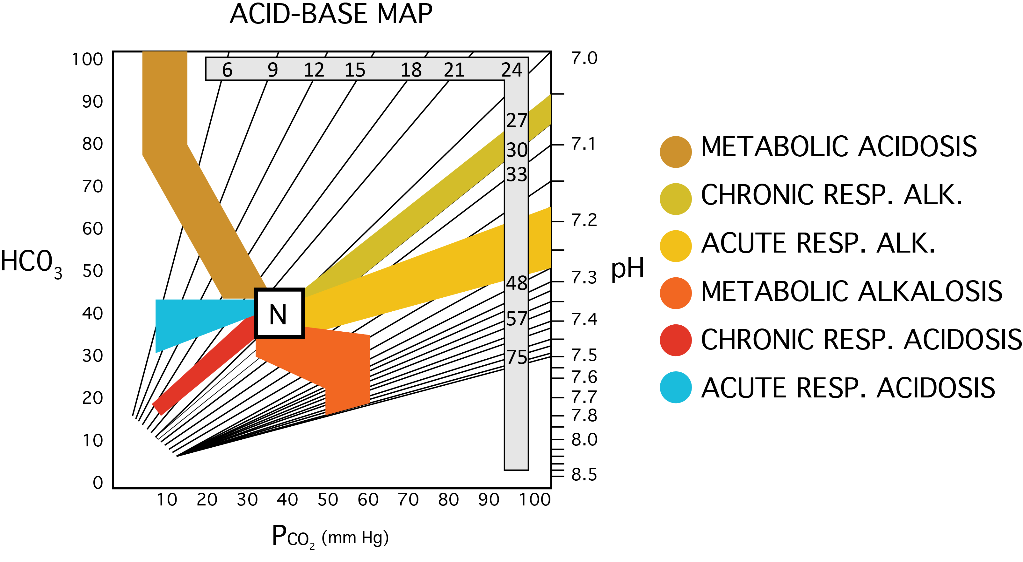
Blood pH confirms Alkaline Way
Siggaard-Andersen acid-base nomogram
Siggaard-Andersen, O. Therapeutic Aspects of Acid-Base Disorders.
Modern Trends in Anaesthesia, Edit. EVANS & GRAY, Vol. 3, p.99, Butterworths, 1967

Slide 59
1st AM Ur pH is Predictive Biomarker
Cell
  Metabolic acid status
  Active mineral status
  Enzyme catalysts pH sensitive
Bone, vessel, and brain health
Protein efficiency >90+% or <10%
Magnesium as essential electrolyte

Slide 60
Predictive Biomarkers: 1st AM Urine pH
Excess acid wears you out
Acidic pH (5.0-6.5)
Healthy Repair / Restore Zone
Neutral pH (6.5-7.5)
Catabolic illness tears you down
Alkaline pH (7.5-8.0)
Clinical Pearl: Keep 1st AM urine pH 6.5-7.5

Slide 61
Biomarkers Solutions: Magnesium, Mg⁺⁺
Magnesium & Choline Citrate:
Gets in when usual uptake blocked;
440-880+ mg elemental magnesium daily
Magnesium displaces toxic minerals
Choline → acetylcholine, cholinergic bile
Citrate → energizes & alkalinizes mitochondria
US Patent # 8,017,160

Slide 62
Now Predictive Biomarkers Known
What enhances health, reduce risk
Separate, overlapping control systems
Causes primary; symptoms consequences
Proactive interventions
Evidence based approaches to risk
Personalized care
Add years to life and life to years

Slide 63
Metabolic Syndrome: Predictive Marker Goals
Blood Sugar
BP Detox
Hgb A1c <5
Homocysteine < 6
ROS
0₃
Prothrombotic PAI-1
‘Sticky’ platelets
Fibrinogen
PCOS (Androgenic Hirsutism)
NAFLD (non-alcoholic liver disease)
NASH (non-alcoholic steatohepatitis
Acanthosis Nigricans: Liver spots
FFA
IR & ROS
Oxidized HDL/LDL
8-oxo-guanine
hsCRP <0.5
NO
Endothelial Dysfunction
Abdominal fat
Oxidized blood fats
Insulin yet less effective
Organ damage from lack of repair
Grundy et al., 2005; Kahn et al., 2005
Notes:
Metabolic syndrome has also been known as: insulin resistance syndrome, dysmetabolic syndrome, syndrome X, and the deadly quartet. But the term “metabolic syndrome” has now taken hold in the medical literature. Recently, the American Diabetes Association proposed a new term – cardiometabolic risk. The intent of this umbrella term is to help professionals understand and manage all cardiovascular and diabetes risk factors.
Prospective population studies show that the metabolic syndrome confers an ~5-fold increase risk for developing diabetes as compared to people without the syndrome and in individuals without diagnosed type 2 diabetes, an ~2-fold increase risk for atherosclerotic cardiovascular disease (ASCVD) events

Slide 64
Predictive Biomarkers for Life
Hgb A1c: Sugar, insulin, energy metabolism
Homocysteine: Methylation, epigenetics, detox
hsCRP: Inflammation, repair ability
Oxidized LDL/HDL & 8 oxo-guanine: antioxidant sufficiency, oxidative free radicals
Vitamin D: Cell communication & adhesion
1st AM urine pH: mineral status & acidosis risk
Notes:
How to add years to life and life to years for each individual: 6 control system markers cover all of physiology. The metabolomic primary predictors of good and ill health.

Slide 65
Predictive Biomarkers Bring Life
Governing Systems for integrative science
Hgb A1c: Sugar, insulin, energy metabolism
Homocysteine: Methylation, epigenetics, detox
hsCRP: Inflammation, repair ability
Oxidized LDL/HDL & 8 oxo-guanine: antioxidant sufficiency, oxidative free radicals
Vitamin D: Cell communication & adhesion
1st AM urine pH: mineral status & acidosis risk
Notes:
How to add years to life and life to years for each individual: 6 control system markers cover all of physiology. The metabolomic primary predictors of good and ill health.

Slide 66
Predictive Biomarkers for Life
Governing Systems for integrative science
You can add or subtract 20-40 quality years
Personalized risk & resilience can be known
Biomarkers show each control system
Together all control systems are quantified
Amounts needed vary; biomarkers predict
Lower costs of care with better outcomes
Apply what is known; remove obstacles
Notes:
How to add years to life and life to years for each individual: 6 control system markers cover all of physiology. The metabolomic primary predictors of good and ill health.

Slide 68
Inflammation Rethought = Remove Repair Blocks
Inflammation =
Lack of Repair =
Obstacle to recovery
Cardiovascular diseases
Diabetes II
Alzheimers
Arthritis
Autoimmune Diseases
Neurological Diseases
Pulmonary Diseases
Cancer
Modified from Grundy et al., 2005; Kahn et al., 2005
Notes:
The spectrum of CHD risk
Individuals at risk for CHD include those with an elevated LDL-C, the metabolic syndrome, or both. The metabolic syndrome is a secondary goal after LDL-C in the ATP III algorithm.
Reference:
Expert Panel on Detection, Evaluation, and Treatment of High Blood Cholesterol in Adults. Executive summary of the third report of the National Cholesterol Education Program (NCEP) Expert Panel on Detection, Evaluation, and Treatment of High Blood Cholesterol in Adults (Adult Treatment Panel III). JAMA 2001;285:2486-2497

